Slide 1
INTERACTIVE SALES DASHBOARD USING POWER BI
Akhil Gaddam | CMR Institute of Technology
B.Tech CSE (Data Science) | July 2024

Slide 2
Objective & Tools
Objective: To design an interactive dashboard for business stakeholders to visualize key sales and financial KPIs for informed decision-making.
Tools Used:
Power BI
Kaggle sales_financial Dataset

Slide 3
KPIs Tracked & Approach
KPIs Tracked:
Total Sales
Total Profit
Profit Margin %
Sales Growth %
Monthly/Quarterly Sales Trends (Time-Series Analysis)
Sales by Region, Category, Segment
Approach:
1.Load and clean the dataset (date corrections, null removal)
2.Create Date Table and DAX measures
3.Build KPI cards, charts, and slicers for interactivity

Slide 4
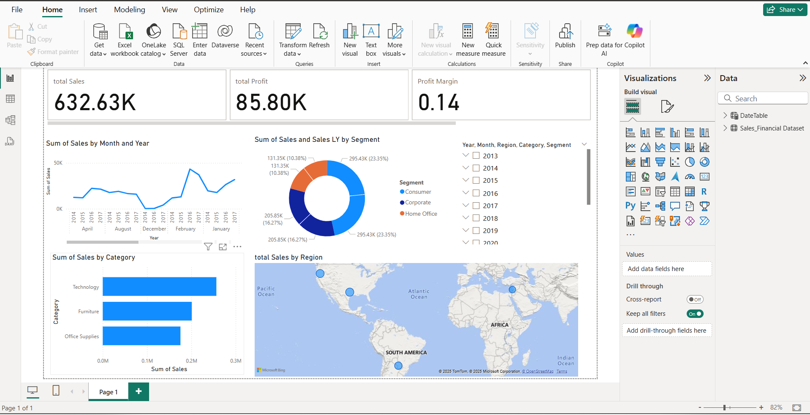
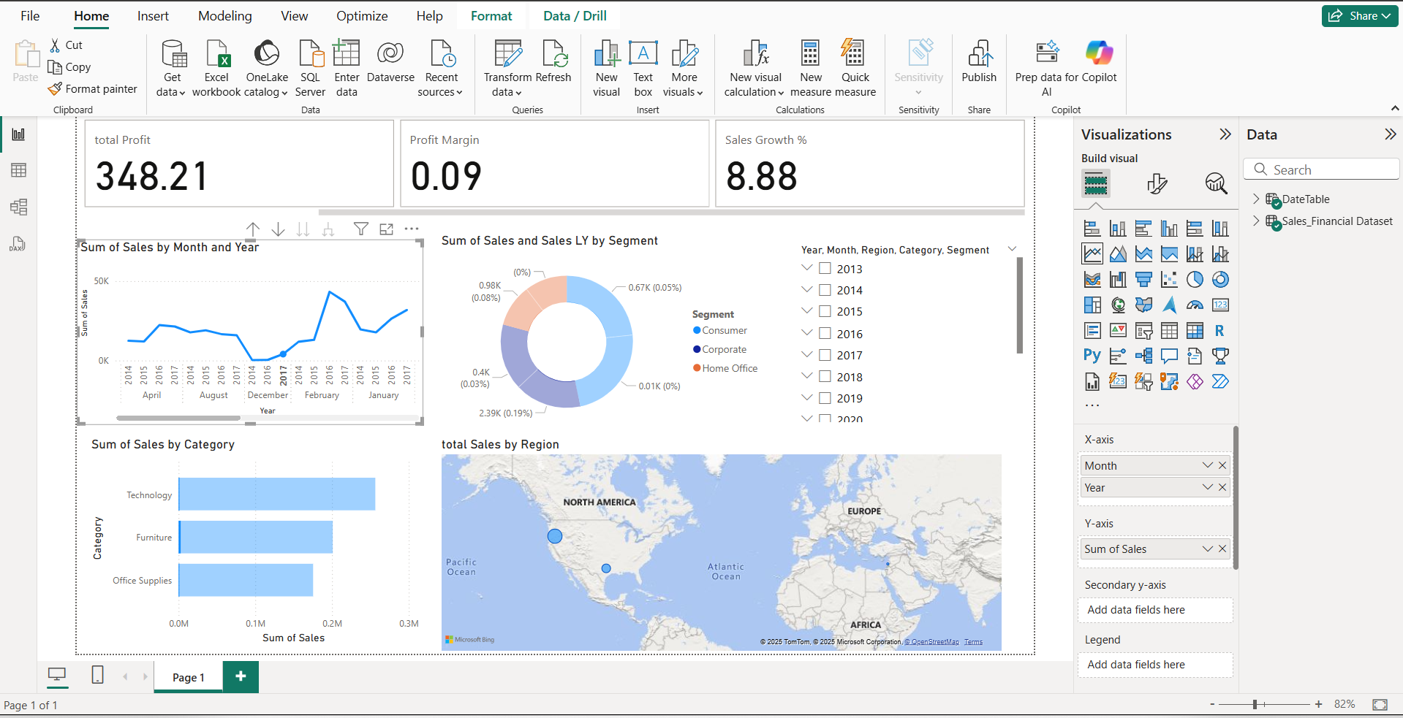
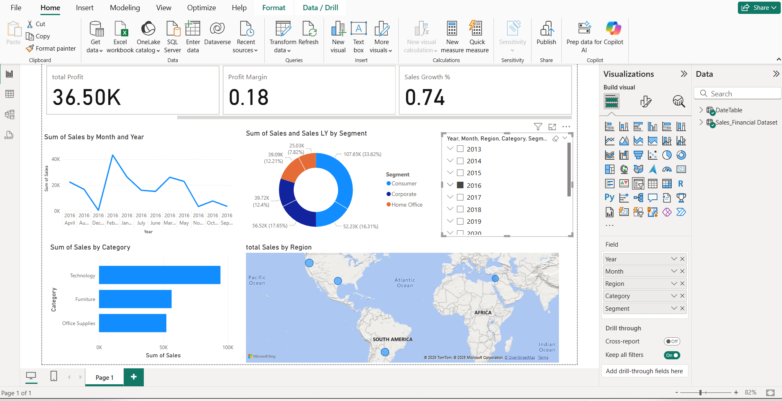
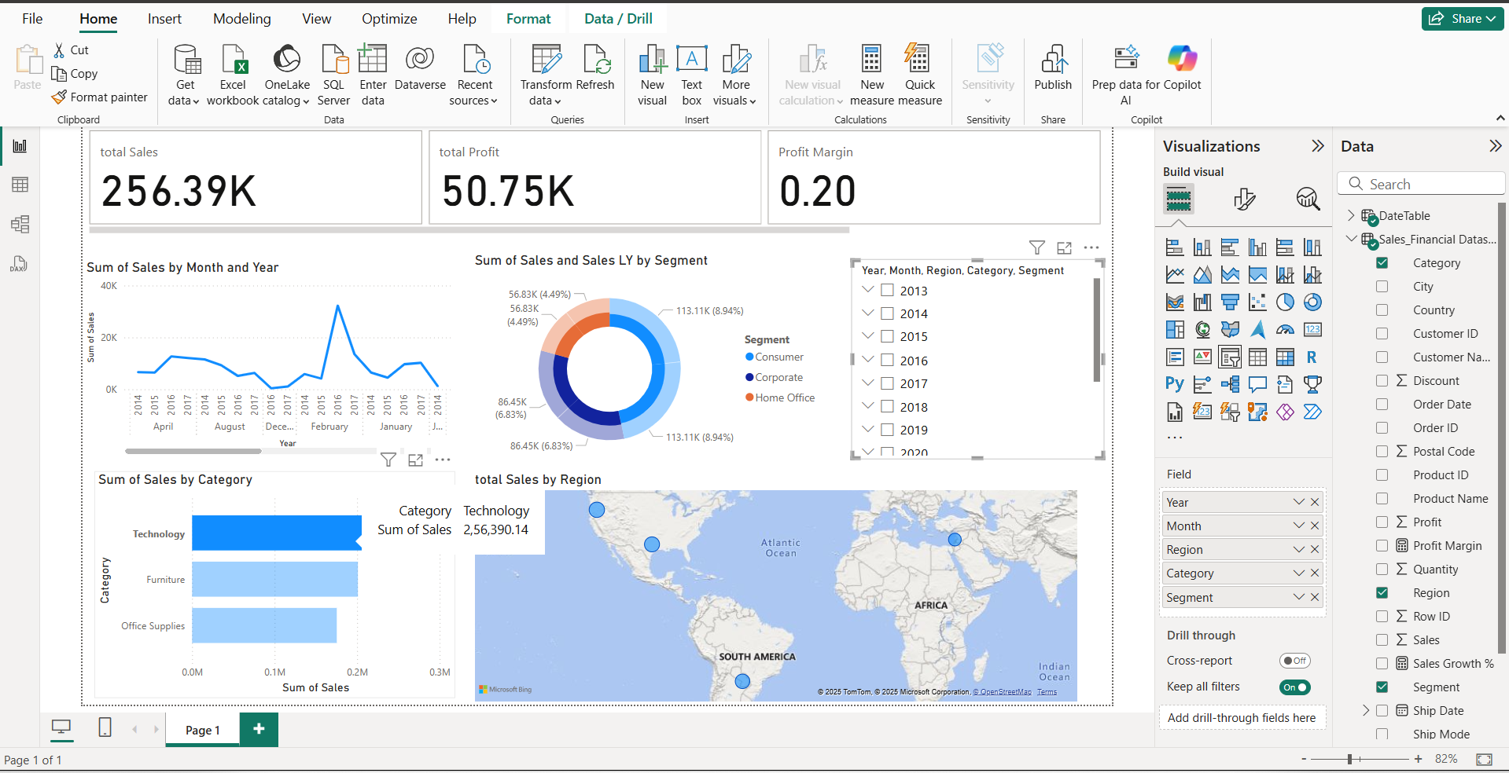
Dashboard Screenshots
1.Full dashboard view and KPI cards (Total Sales, Profit, etc.)
2.Line chart showing sales trends over months/quarters
3.Slicers for Year, Region, Segment for interactivity
4.Bar chart for sales by category

Slide 5
Key Insights
Total Sales are $632.63K, indicating strong sales performance across tracked periods.
Total Profit is $85.80K, showing consistent profitability.
Profit Margin is 14%, indicating scope to further improve operational efficiency.
The United States, contributing the highest sales volume geographically.
The Technology, leading in sales among all categories.
Sales show consistent growth with visible peaks in early 2017, indicating seasonal or promotional sales spikes.
Consumer segment has the highest contribution, indicating a strong B2C performance trend.
The dashboard enables interactive filtering by Year, Region, Category, and Segment, helping stakeholders analyze data flexibly for informed decision-making.
Thank You

